Slide 1

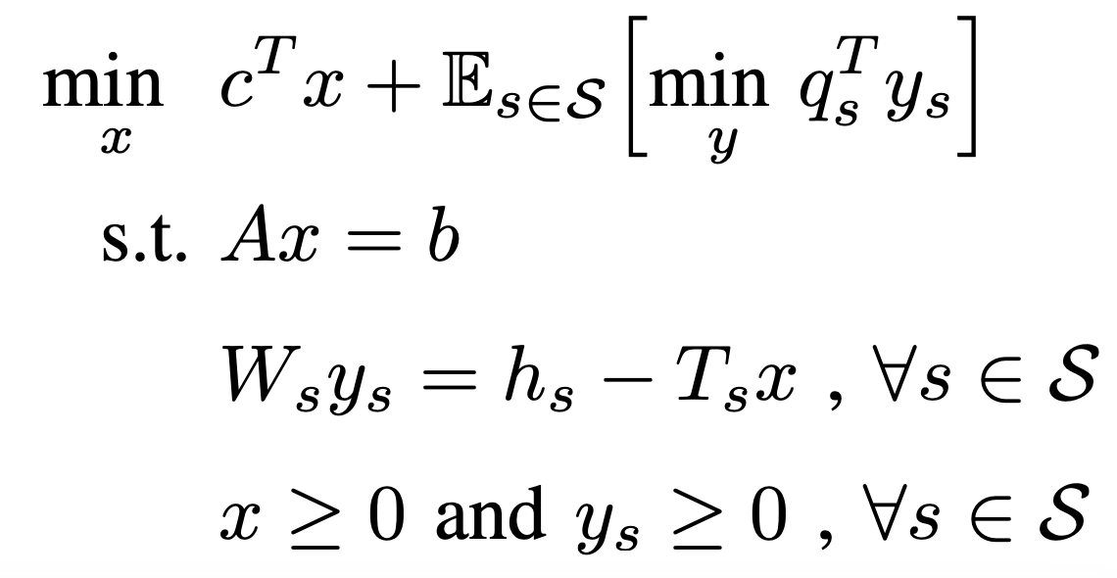
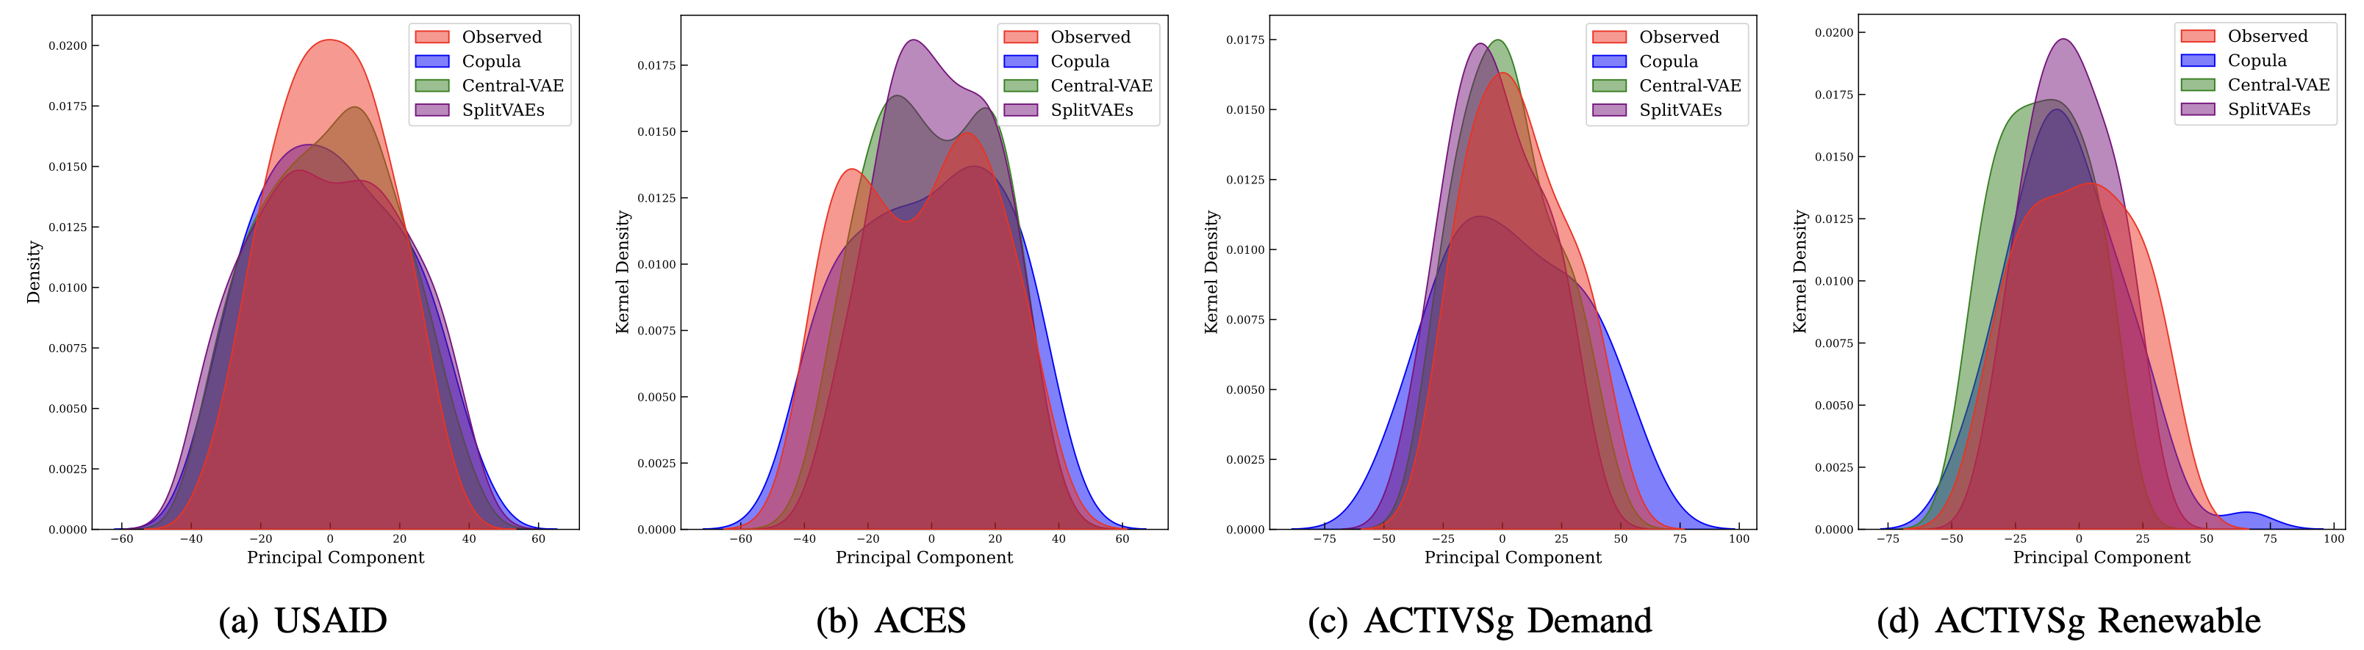
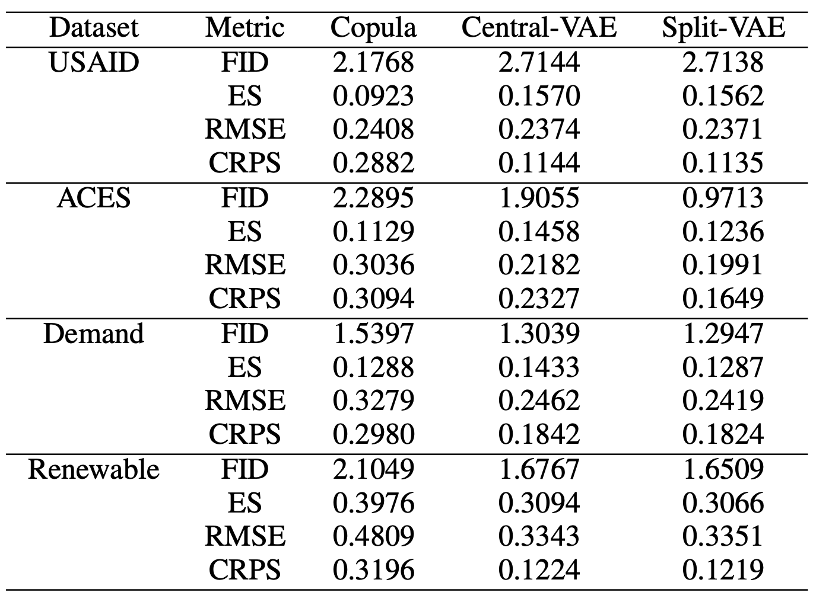
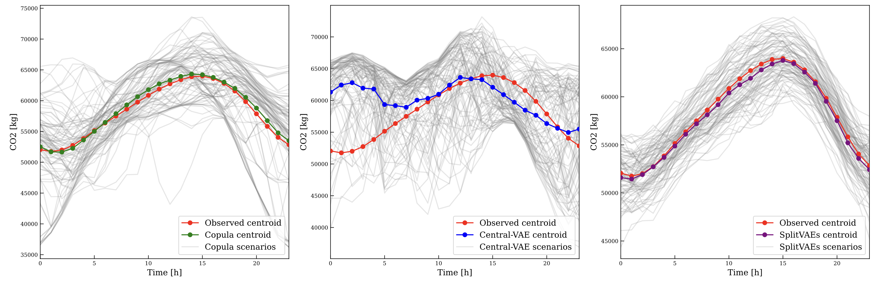
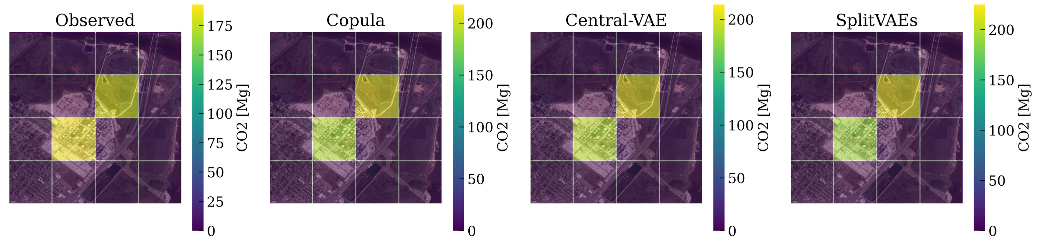
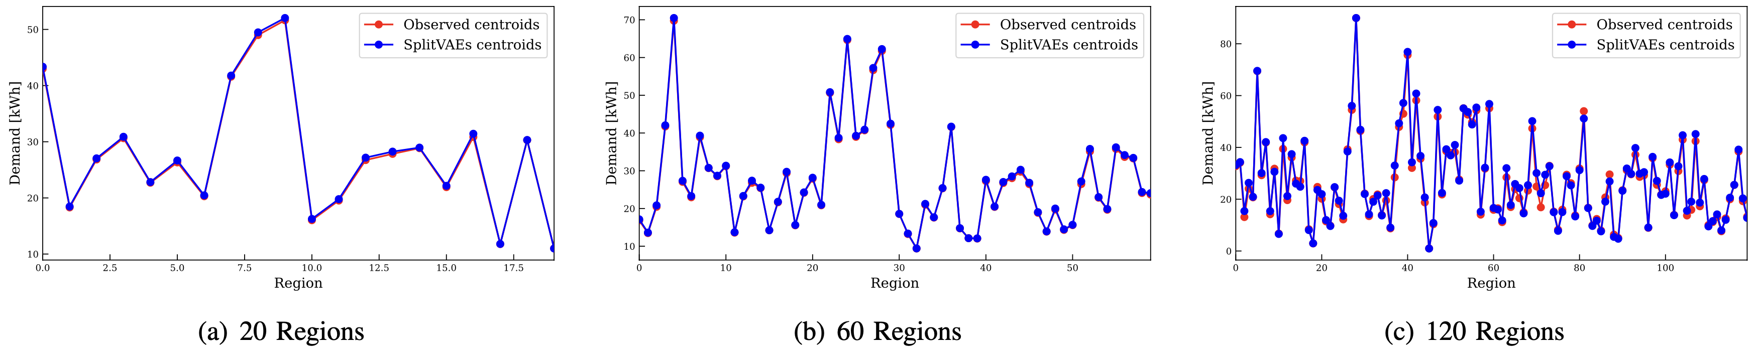
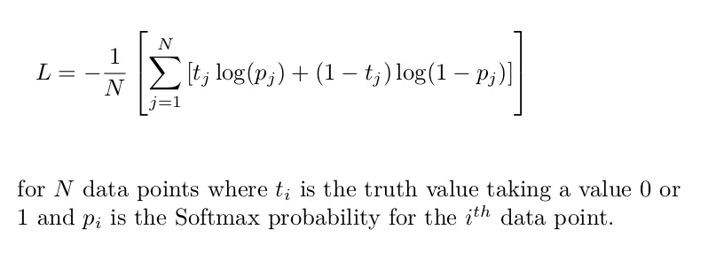
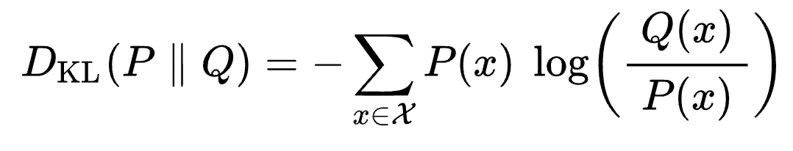
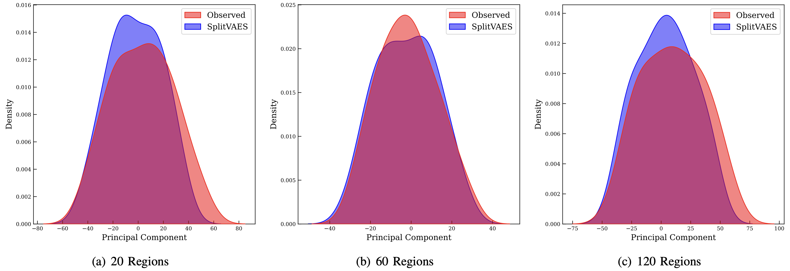
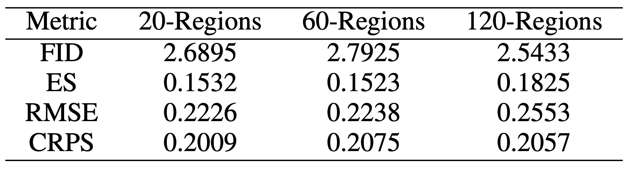
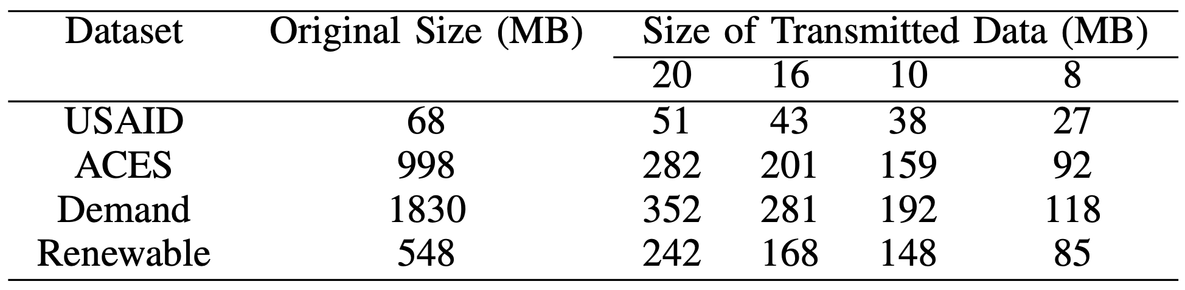
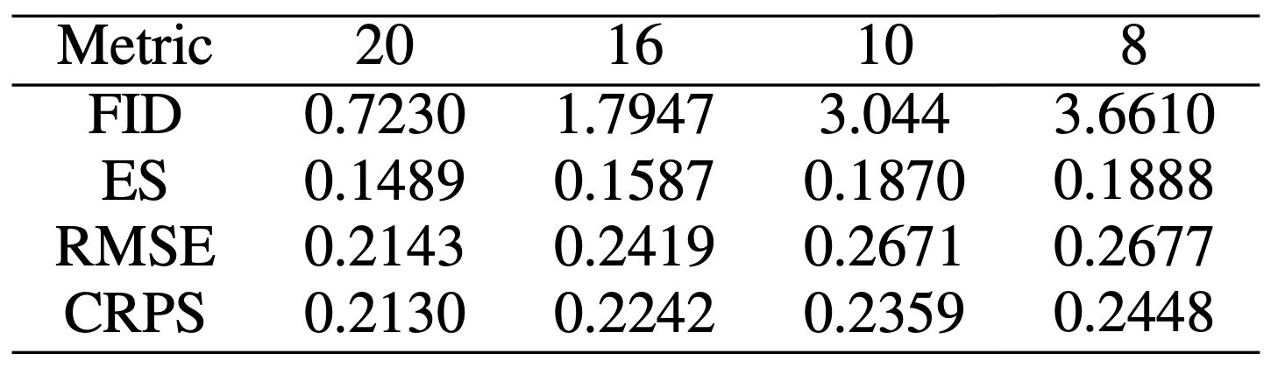
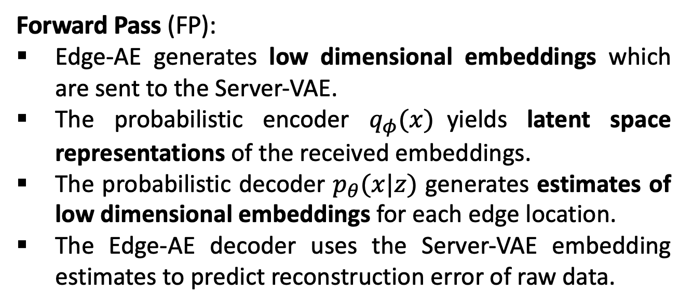
SplitVAES - Decentralized scenario generation from siloed data for stochastic optimization problems
Islam H M Mohaimanul; Huynh Q. N. Vo; Paritosh Ramanan
School of Industrial Engineering and Management, Oklahoma State University
MOTIVATION
RESULTS
Research Objectives
COMPUTATIONAL ARCHITECTURE
Stochastic planning and optimization (SO) in large-scale, multi-stakeholder, networked infrastructure systems requires spatiotemporally interdependent data-driven scenarios
Centralized aggregation of stakeholder data is challenging due to privacy, computational, and logistical bottlenecks.
Spatiotemporal interdependencies are difficult to capture without centralized data aggregation from all stakeholders.
Applicability to Diverse Case Studies
Simple two-stage, linear, stochastic optimization formulation as an example
CONTRIBUTIONS
We propose a decentralized machine learning (ML) approach that:
Leverages edge-based autoencoders with server-driven variational autoencoder to capture global spatiotemporal interdependencies from siloed data.
Decomposes global backpropagation steps across edge and server models, enabling the bi-directional flow of learning insights without moving raw data.
Enables a scalable, real-world implementation to generate scenarios for stochastic optimization problems without the need to move data.
Handles heterogeneous datasets across diverse areas by comparing the generated scenarios with established benchmark methods.
Embedding distributions between observed data and generated scenarios by different methods across four case studies
FRAMEWORK DESIGN
Time series analysis of carbon dioxide emissions scenarios compared with observed data in Port Arthur, Texas.
Server-level variational autoencoder (Server-VAE): yields latent space embeddings with the help of a probabilistic encoder, then uses the mean and variance of the latent embeddings to generate latent space representations; finally, the representations are fed to a probabilistic decoder to obtain the reconstructions of the raw data.
Edge-level autoencoder (Edge-AE): deep neural network (DNN) encoder and decoder models; the encoders receive siloed time-series data from each stakeholder to yield low-dimensional embeddings, while the decoder reconstructs the input data from these embeddings.
Loss functions: two loss functions are used in the training mechanism of our proposed framework.
Reconstruction Loss: the binary cross-entropy function is employed to measure the mean reconstruction error between predicted values and observed values.
Kullback-Leibler (KL) Loss: the KL loss measures the disparity between the learnt latent space embedding and the reference distributions.
Forward Pass (FP):
Edge-AE generates low dimensional embeddings which are sent to the Server-VAE.
The probabilistic encoder $q_{φ}(x)$yields latent space representations of the received embeddings.
The probabilistic decoder $p_{θ}(x|z)$ generates estimates of low dimensional embeddings for each edge location.
The Edge-AE decoder uses the Server-VAE embedding estimates to predict reconstruction error of raw data.
Backward Pass (FP):
Edge-AEs receive embedding estimates and compute prediction error using decoder.
The errors on the input layer are distributed back to the Server-VAE.
The received errors are backpropagated through the VAE to yield errors at the VAE input layer.
VAE input errors are distributed to Edge-AEs where they are backpropagated through the encoder
Benchmarking evaluation metrics (FID, ES,RMSE, CRPS) across four different datasets.
Geographical heatmap illustrating the concentration of carbon emission volume profile in Port Arthur, Texas
Handling Dimensional Heterogeneity
COMPUTATIONAL PERSPECTIVES AND BENEFITS
Binary cross-entropy as Reconstruction Loss
KL Divergence to compare two distributions
Planning and Optimization for Nodal Authorities
SplitVAEs enable nodal authorities (NA) such as control towers in supply chains, and Independent System Operators (ISOs) in power systems to optimize and plan for the entire network without needing to move stakeholder data.
Using SplitVAEs as a NA can generate scenarios by using the latent space dimensions learned by the Server-VAE in conjunction with the trained Edge-AEs to use for SO problems.
Applicability to a Diverse Case Studies:
SplitVAEs performance is nearly identical to that of most centralized training schemes like the Gaussian copula and the Central-VAE in respect to evaluation metrics.
All methods can capture the underlying data distributions, as indicated by the embedding distribution graphs and the spatiotemporal information of the observed data is captured in a high-fidelity fashion.
Handling Dimensional Heterogeneity
The SplitVAEs model can handle heterogeneity in embedding dimensions as illustrated by varying the region decompositions in ACTIVSg dataset leading to different embedding sizes for each Edge-AE.
Architecture Scalability
SplitVAEs demonstrate an inherent robustness to varying sizes of latent dimensions in the server VAE and the dimensions of the edge encoders and decoders.
Reduction in Data Movement
SplitVAEs highlight the ability of edge devices to generate compact low dimensional embeddings which is an essential consideration for transmission speed in data-rich environments.
SplitVAEs enable reduction in data transmission costs and help save on bandwidth and latency associated with streaming.
Time series analysis of scenarios generated in three different region decompositions (20-60-120) compared with observed data for ACTIVSg-Load dataset
EVALUATION METHODS
Benchmark: We compare the SplitVAEs with centralized scenario generation methods, including the Gaussian copula and the Central-VAE method. We also employ the t-SNE technique to visualize the kernel density distribution of the generated scenarios, transformed into one-dimensional embeddings.
Metrics: We employ multiple quantitative evaluation metrics to measure the quality of the generated scenarios namely Fréchet inception distance (FID), Energy Score (ES); Root-mean-square Error (RMSE), and Continuous Ranked Probability Score (CRPS).
Datasets: We primarily evaluated the decentralized scenario generation capability of our proposed framework using the USAID, ACES, and ACTIVSg datasets.
USAID: the Order Cycle Time information of 85 distributors from 2017 to 2023 are used.
ACES: carbon emission profiles for 25 petroleum refineries in Texas for summer seasons in 2017.
ACTIVSg: load and renewable data from the 2000 bus transmission system test case for Texas.
Hardware Setup: Our experiments are conducted on Pete Supercomputer.
Software Setup: All experiments were conducted OpenMPI distributed memory framework, available as mpi4py, in Python. The PyTorch library is used for constructing, training and evaluating the machine learning models.
Effect of local sub-problem sizes on quality of generated scenarios
Embedding distributions and metrics between observed data and generated scenarios by different region decompositions
Reduction in Data Movement
Size of data transferred with varying edge-level latent dimension
Effect of varying latent dimensions of edge device level
CONCLUSION
REFERENCES
Summary and Future Work
Y. Li, J. Li, and Y. Wang, “Privacy-preserving spatiotemporal scenario generation of renewable energies: A federated deep generative learning approach,” IEEE Transactions on Industrial Informatics, vol. 18, no. 4, pp. 2310–2320, 2021.
C. Goncalves, R. J. Bessa, and P. Pinson, “Privacy-preserving distributed learning for renewable energy forecasting,” IEEE Transactions on Sustainable Energy, vol. 12, no. 3, pp. 1777–1787, 2021.
J. Liang and W. Tang, “Sequence generative adversarial networks for wind power scenario generation,” IEEE Journal on Selected Areas in Communications, vol. 38, no. 1, pp. 110–118, 2019.
M. Jia, C. Shen, and Z. Wang, “A distributed probabilistic modeling algorithm for the aggregated power forecast error of multiple newly built wind farms,” IEEE Transactions on Sustainable Energy, vol. 10, no. 4, pp. 1857–1866, 2018.
P. Pinson, H. Madsen, H. A. Nielsen, G. Papaefthymiou, and B. Klockl, ¨ “From probabilistic forecasts to statistical scenarios of short-term wind power production,” Wind Energy: An International Journal for Progress and Applications in Wind Power Conversion Technology, vol. 12, no. 1, pp. 51–62, 2009.
We demonstrate the applicability and feasibility of SplitVAEs specifically in the context of multi-stakeholder infrastructure systems by leveraging real world datasets.
We establish the feasibility and superior computational performance of our proposed method in various aspects including performance comparison with other approaches, architecture scalability and ease of data movement according the above experiments.
Overall, SplitVAEs are a compelling alternative that enables scenario generation for SO problems in multi- stakeholder-led infrastructure systems without the need to transfer underlying datasets.
This project is featured as a finalist for Best Student Paper Competition in IISE 2024 Annual Meetings in Montreal, Canada.
This project is under review for The International Conference for High Performance Computing, Networking, Storage, and Analysis (SC2024) in Atlanta, GA.

